Slide 1
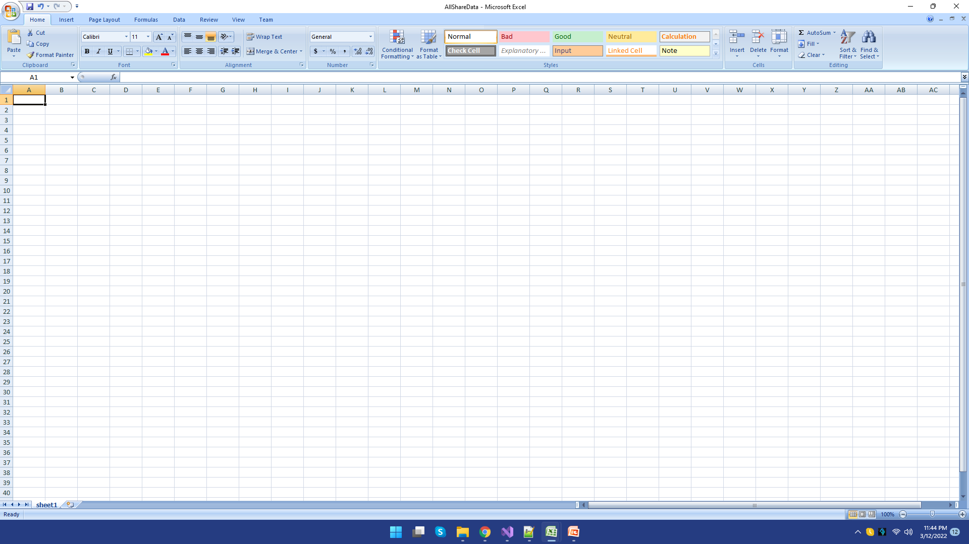
Step 1 : empty excel file

Slide 2
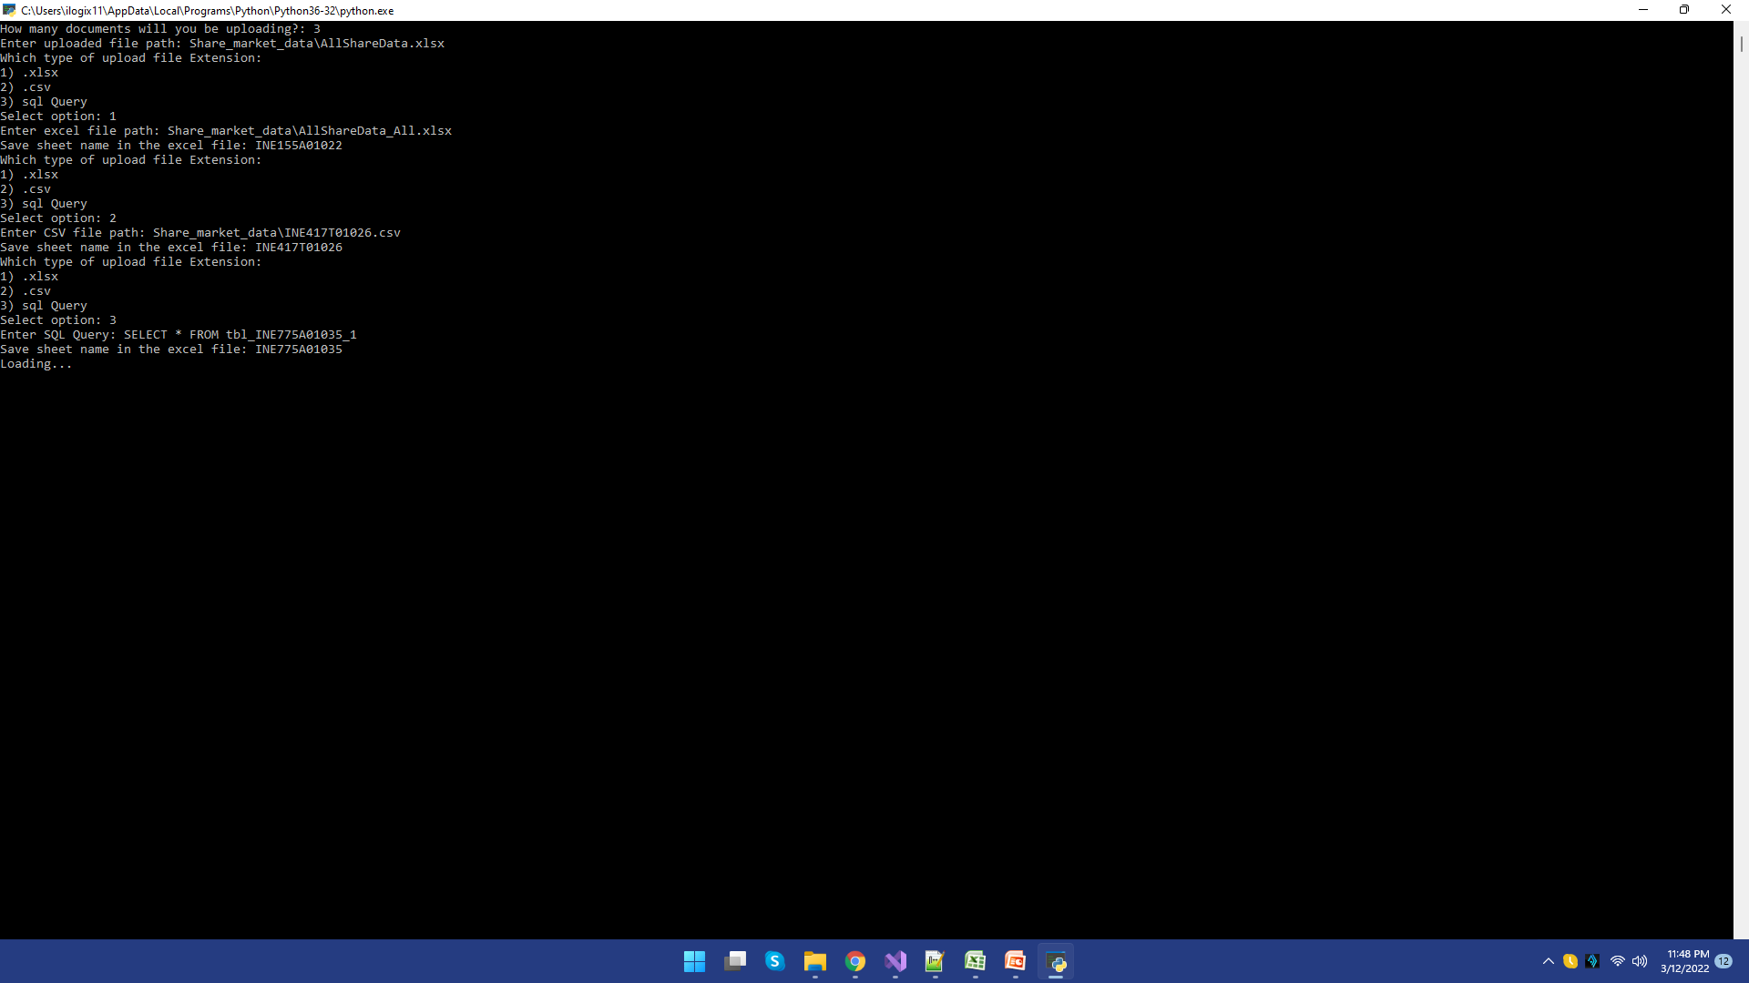
Step 2i: Waiting

Slide 3
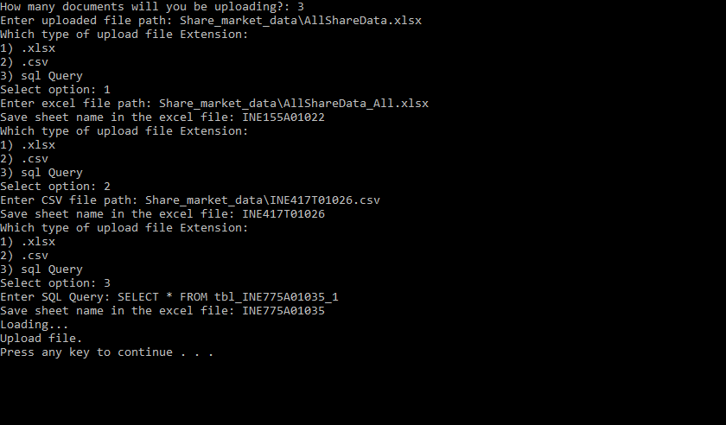
Step 2ii: Updated File complete

Slide 4
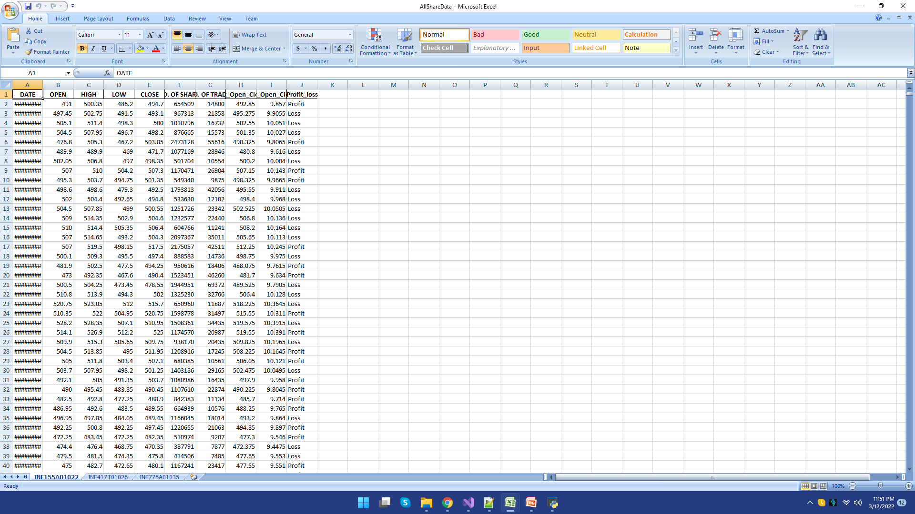
Adding 3 column using python
Step 3: Final file

